Slide 1
Welcome to WELLNESS

Slide 2
NAMASTE
Chill out, stretch out, and find your inner strength with yoga.

Slide 3
YOGA etiquette
Arrive on time; If you arrive a few minutes late due to an unforeseen circumstance, check through the door and enter quietly either before or after the silent centering practice. Minimize disruption as much as possible.
Remove your shoes prior to entering the class.
Its good to wear modest clothes that can move with you.
Respect others. Practice silence during class.
Sanitize mats before and after yoga practice. Roll them up and put away.
No cell phones and or other electronic devices.

Slide 4
History of YOGA
Yoga means UNION. The mind, body, and breath are one, working together.
The origin of Yoga is a mystery.
People who practice yoga are called – yogis.
There are several different types of yoga, but they all have the same goal. Connect the mind, body and breath.

Slide 5
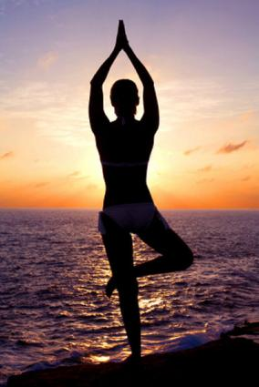
Who does YOGA?
Athletes
People who need healing: scoliosis, cancer, depression, carpal tunnel, etc.
Bendy people: helps add strength, balance and power.
Stiff people: ease aches and pains, give confidence in your body’s abilities.
Young people
Old people: activates tired muscles
Teens: helps stress, hormones, calming, etc.

Slide 6
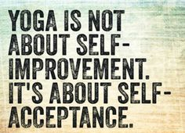
YOGA as a way of life
Personal practice, but also about being a positive force in the world.
Yoga encourages kindness and positive thoughts in all you do.
Focus on breath and eliminate chatter in your mind, you can start to become fully present, living in the moment.

Slide 7
What will you LEARN
Essential asana (poses) and sequences
How to use yoga as a way to de-stress, find balance, breathe easy, and improve posture & flexibility.
How to practice proper breath control during yoga.
The physical benefits (improved strength, flexibility, balance, endurance) and mental benefits (improved focus and aim, control of body, connection between breathing with movement, and stress-relief) of yoga.

Slide 9
4 Benefits of keeping a Yoga Journal.
Awareness - Writing clarifies jumbled thoughts and feelings, allowing us to become familiar with what we enjoy, struggle with, and want to pursue.
Gratitude - Journaling after a yoga practice cultivates gratitude for our practice and ourselves. As we document challenges, lessons, and progress, we come to appreciate our journey–regardless of where we are.

Slide 10
Cont.
Trust - Exercising self-trust and expression through writing returns our focus to who we are and what we want.
Health - Research shows that writing can help us cope with and overcome stressful events, thus reducing their mental, emotional, and physical stressors on our health.

Slide 11
YOGA QUIZ
What’s your Yoga style?

Slide 12
What do you really expect from a yoga class?
a. It should be a great workout- I want to sweat and feel sore the next day.
b. I like hard work but am most interested in alignment and how each pose should actually feel.
c. I just like to relax with gentle stretches and then pass out.
d. I want to meditate about my boyfriend.

Slide 13
2. Which bedroom do you identify with most?
a. A canopy bed and homework all over your desk, scrapbooks, photographs, softball glove on the floor.
b. A modern bed with everything in the right place. Homework done and in a neat pile. Books lined up. Color coded wardrobe.
c. Sweet bunny bed with your dog curled up at the end. Your own paintings on the wall. Poetry, letters, and phrases stuck all over your wall.
d. Hammock tied to two palm trees, preferably with a monkey.

Slide 14
3. For fun, which do you prefer to do?
a. Rally a game of football or tennis or find friends to go hiking – anything active.
b. Organize my music collection, take a walk, read a great book, or go shopping.
c. Find a beautiful spot in nature to just sit and think.
d. I’d wear a wig and walk around town getting to know people.

Slide 15
4. How would you act in a yoga class?
a. I would fly in late after my tournament, beg to borrow a mat, and kick off a conversation with the nearest yogi.
b. I would arrive early, line up my mat, blocks, and props neatly before me.
c. I would arrive on time and melt into Child’s pose or a deep meditative state to mentally prepare for the class.
d. I would bring in my hedgehog, sit him on my mat and hide until the yoga teacher noticed it wasn’t me.

Slide 16
Your YOGA style
Mostly A’s – Power Yoga or Hot yoga
Mostly B’s – Precise Yoga
Mostly C’s – Spiritual Yoga (meditation)
Mostly D’s – Shouldn’t do Yoga!! Maybe try hockey.

