Slide 1
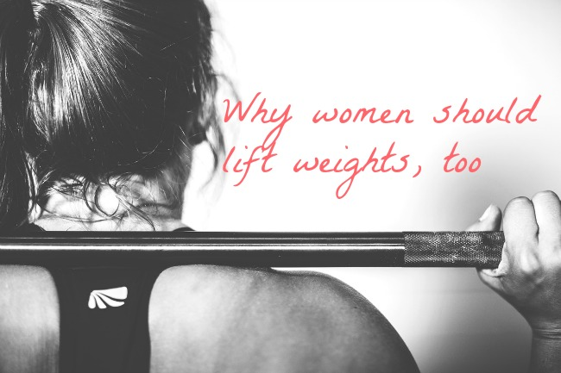
Resistance Training

Slide 2
You’ll Burn more Calories
Just sitting on your butt reading this, you're burning calories—if you lift weights, that is. Your muscle mass largely determines your resting metabolic rate—how many calories you burn by just living and breathing. "The more muscle you have, the more energy your body expends," says women's strength expert Holly Perkins, CSCS.

Slide 3
You’ll be stronger mentally
By constantly challenging yourself to do things you never thought possible, your confidence grows. "Weight lifting empowers you".

Slide 4
You’ll boost your flexibility
Researchers from the University of North Dakota pitted static stretches against strength-training exercises and found that full-range resistance training workouts can improve flexibility just as well as your typical static stretching regimen.

Slide 5
You’ll strengthen your bones
Weight lifting doesn't only train your muscles; it trains your bones. When you perform a curl, for example, your muscles tug on your arm's bones. The cells within those bones react by creating new bone cells, Perkins says. Your bones become stronger and more dense.

Slide 6
You’ll ease joint pain
"Stronger muscles better hold your joints in position, so you won't need to worry about your knee flaring up during your next run."

Slide 7
You’ll be a better runner
Stronger muscles mean better performance—period. Your core will be better able to support your body's weight and maintain ideal form during other exercises (like running), plus your arms and legs will be more powerful. What's more, since strength training increases the number and size of calorie-torching muscle fibers fueling your performance, strength training could actually help you burn more calories during your cardio workouts.

Slide 8
You’ll have a healthier heart
In one Appalachian State University study, people who performed 45 minutes of moderate-intensity resistance exercise lowered their blood pressure by 20 percent. That's as good as—if not better than—the benefits associated with most blood pressure pills.

Slide 9
You’ll drop a size
"Women produce about 5 to 10 percent the amount of testosterone men do, limiting our muscle-building potential when compared to men," Sinkler says. To seriously gain size, you'd pretty much need to live in the weight room.

Slide 10
Fitness Magazine
http://www.fitnessmagazine.com/workout/lose-weight/build-strength/benefits-strength-training/?page=6

