Slide 1
High Intensity Interval Training
Do HIIT Now. Sometimes later becomes never.

Slide 2
CLASS GOALS.
1. Abdominal strength.
2. Upper body strength.
3. Lose Weight.

Slide 3
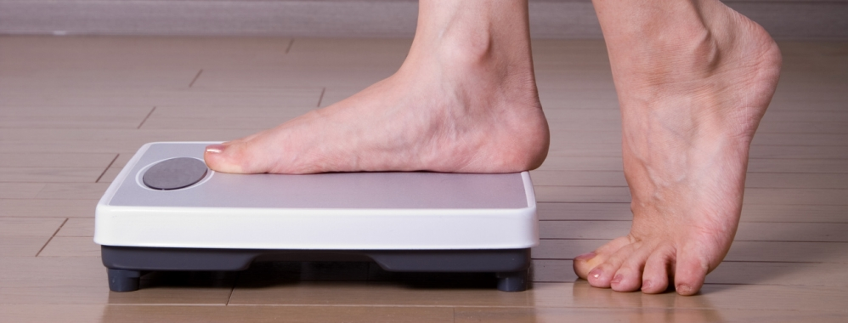
What is your WEIGHT?
Brain – 3lbs
Intestines – 7.5lbs
Liver – 3.5lbs
Lungs – 5lbs
Bones – 15% of weight (20-22lbs)
Skin (hair, nails) – 16% of weight (20-22lbs)
Blood – 7%
Water – 1.5lbs

Slide 4
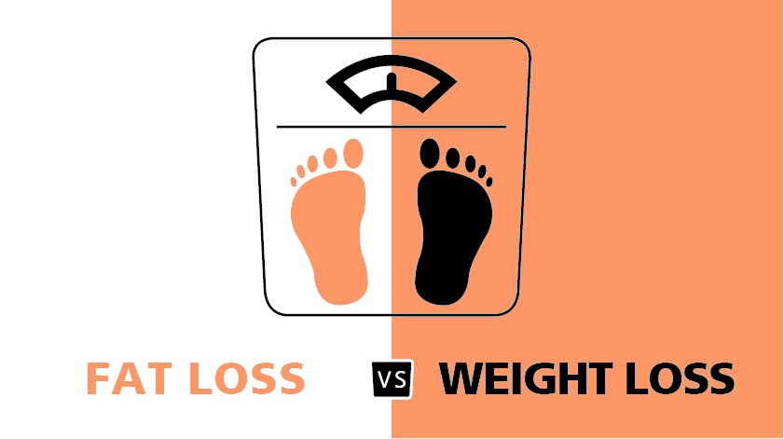
Which Weighs MORE?
Muscle
Fat
1lb of muscle = 1lb of fat
More dense and compact
Muscles take up less space in your body, so body weight may go up as you add compact, tight muscle mass.
1lb of fat = 1lb of muscle
Less dense more fluffy
Ex. If you look at 5lbs of muscle and 5lbs of fat side by side, fat takes of more volume/space.

Slide 5
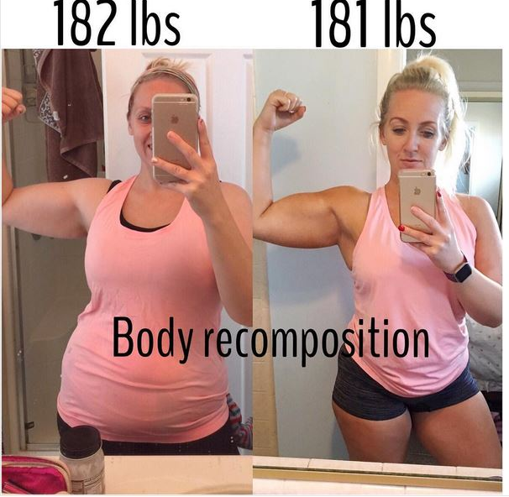
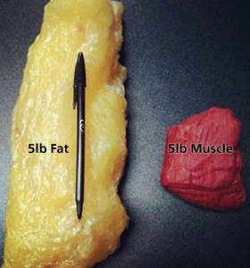

Slide 6
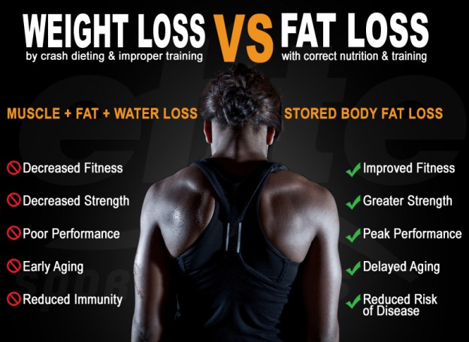

Slide 7
What is HIIT?
High Intensity Interval Training - short, intense, unsustainable bursts of physical activity, paired with intervals of quick rests.
10 minutes. – 45 minutes.
Can be done anywhere – usually no equipment needed.
Performed 80%-95% of maximum heart rate.
170-190 would be Target Heart Rate
Can be modified for all fitness levels.

Slide 8
Benefits of HIIT
Burn more calories – doing 15 minutes of HIIT > jogging for 1 hour.
Build endurance.
Boost metabolism – born more calories at faster rate.
Burn calories after workout – 24 hours after workout, still burning calories.
Lose fat, not muscle – weight training.
No equipment.
Challenging – never get bored.

Slide 9
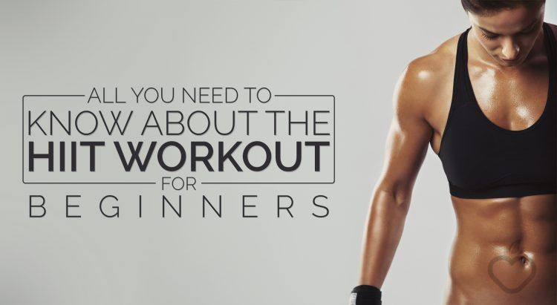
HIIT Video
https://www.youtube.com/watch?v=2GgKm_54kXI

